Slide 1
Online Food Delivery System (Friendly Café)
Get Food Delivered at your Door Step

Slide 2
TEAM MEMBERS
2583380 Siddhartha Raj - TL
2582645 Sourabh R Kurne
2583161 Subham Kumar Pandit
2583462 Uppaluri Venkata Syamala Rajyasree
2582878 Vema Prudhvi Sai
2583274 Vinita X
2583569 Vishwanath Havaldar
2583521 Yarrajeni Divya Sri

Slide 3


Slide 4
ABSTRACT INTRODUCTION OBJECTIVE TECHNOLOGY

Slide 5
ABSTRACT
In this project, we have created a full stack web application called Friendly Cafe, an Online Food Delivery System.
We have used springboot for backend, angular for frontend and mysql for database.
In this, user can signup/login and order foods through online payment.
Admin can login and do all the crud operation on products, customer and purchases.

Slide 6
INTRODUCTION
The "Online Food Delivery System" has been developed to override the problems prevailing in the practicing manual system Moreover, this system is designed for the particular need of the company to carry out operations in a smooth and effective manner.
The application is reduced as much as possible to avoid errors while entering the data. It also provides error message while entering invalid data. Thus, by this all it proves it is user-friendly.
Every organization, whether big or small, has challenges to overcome and managing the information of Category, Food Item, Order, Payment, Confirm Order.

Slide 7
OBJECTIVE
To provide a bug-free Online Food Delivery system to Users as well as Admin.
The main objective is here to provide a nice and secure platform for Ordering Food.
To maintain the records of Product, Category available into the system

Slide 8
Tools/Technologies
Front End - Angular
Backend - SpringBoot
Database - MySQL,Hibernate

Slide 9
Spring boot
Spring Boot is a Java framework, built on top of the Spring, used for developing web applications.
Spring Boot is a backend framework that has become a major player in the enterprise Java EE.
No requirement for complex XML configurations.
It allows you to create REST APIs with minimal configurations.

Slide 10
Rest API
API is to standardize data exchange between web services. Depending on the type of API, the choice of protocol changes.
REST API is an architectural style for building web services that interact via an HTTP protocol.
In Spring's approach to building RESTful web services, HTTP requests are handled by a controller
REST stands for representational state transfer.
Postman is an application used for API testing. It is an HTTP client that tests HTTP requests, utilizing a graphical user interface, through which we obtain different types of responses that need to be subsequently validated.

Slide 11
Backend Flow
Creating Entities ,Controllers for the below Modules
Admin
Cart
Contact Form
Category
Food
Order
Review
User
Performing CRUD operations for above Modules using JpaRepository

Slide 12
Dependencies and Annotations required:
Spring Data JPA – Java Persistence API and Hibernate.
Spring Web – To include Spring MVC and embed Tomcat into your project.
Spring Boot DevTools – Development Tools.
MySQL Driver – JDBC Driver (Connecting Spring Boot to the Database)
Junit

Slide 13
Dependencies and Annotations required:
Spring Data JPA – Java Persistence API and Hibernate.
Spring Web – To include Spring MVC and embed Tomcat into your project.
Spring Boot DevTools – Development Tools.
MySQL Driver – JDBC Driver (Connecting Spring Boot to the Database)
Junit

Slide 14
Dependencies and Annotations required:
@Autowired : To the UserRepository for dependency injection.
@GetMapping and @PostMapping: To specify the type of HTTP requests accepted
@RestController : It is a combination of @Controller and @ResponseBody
The @RequestBody : It is used to map the body of the POST request sent to the endpoint to the User instance to save.

Slide 15
Angular
Angular is a TypeScript-based free and open-source web application framework lead by the Angular Team at google and by a community of individuals and corporations. Angular is a complete rewrite from the same team that built Angular js.
Angular is a JavaScript (actually a TypeScript based open-source full-stack web application) framework which makes you able to create reactive Single Page Applications (SPAs). Angular is completely based on components. It consists of several components which forms a tree structure with parent and child components.

Slide 16
FEATURES OF ANGULAR
Cross-platform
Efficient MVC architecture
Data binding
Set of Directives
Prominence of TypeScript
Declarative UI
Extensive documentation and support
Timely upgradations

Slide 17
Components in Angular
Home
Header
Admin login
Admin dashboard
Product
Cart
Manage category
Manage purchase
Food Items
User Login
User dsshboard
Payment gateway
Order summary

Slide 18
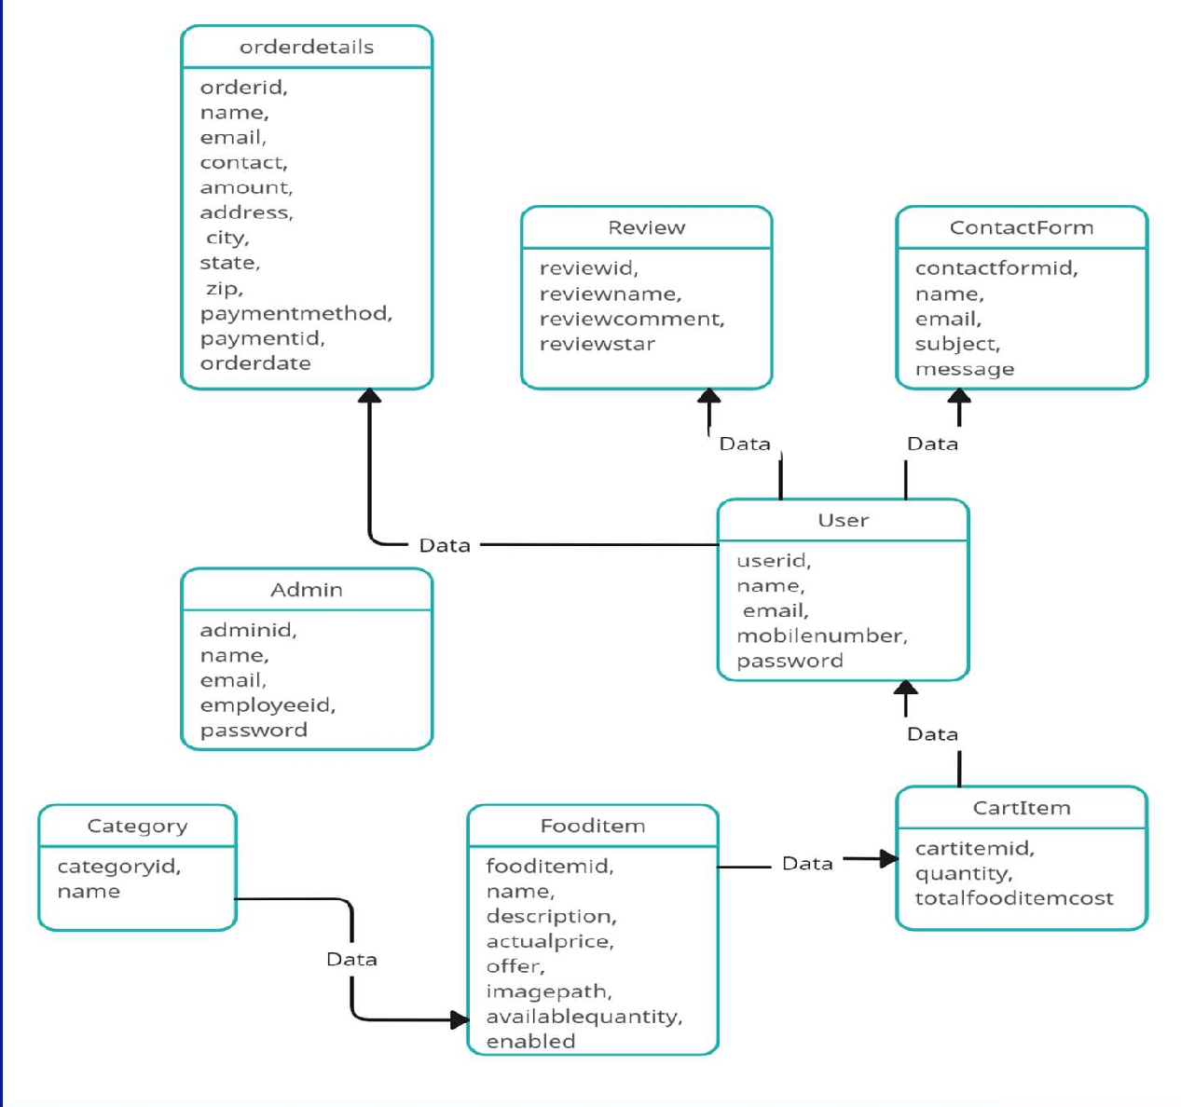
ER DAIGRAM

Slide 19
Integration
Backend is connected to frontend through the service.ts files.
In service.ts files, httpclient url of backend is added here for integration.
class AdminService {
private baseURL="http://localhost:8080/admin"
constructor(private httpClient:HttpClient) { }
Similarly frontend is connected to backend through cross origin annotation.
@CrossOrigin(origins = "http://localhost:4200")

Slide 20
MySQL database is connected to the backend application.properties file.
spring.datasource.url=jdbc:mysql://localhost:3306/foodbox
spring.datasource.username=root
spring.datasource.password=password

Slide 21
Testing In Spring BooT
Testing is a procedure that makes sure the software meets the standard set by the requirements specification and operates smoothly with the fewest number of bugs as feasible.
A variety of tools and annotations are offered by Spring Boot to make testing your application easier. Two modules are used to provide tests: spring-boot-test contains the essential components, and spring-boot-test-autoconfigure supports test auto-configuration.

Slide 22
Types of Testing
As per testing in our spring boot project is concerned there are 2 types of testing.
J-Unit Testing
Rest-Api Testing
You can use the JUnit framework to call a method and verify (or assert) that the output is what you expected.
For Unit Testing we need an annotation called @test which comes from JUnit Dependency.

Slide 23
Rest-Api Testing
Representational State Transfer (REST) is an architectural style that defines a set of constraints to be used for creating web services. REST API is a way of accessing web services in a simple and flexible way without having any processing.
All communication done via REST API uses only HTTP request.

Slide 24
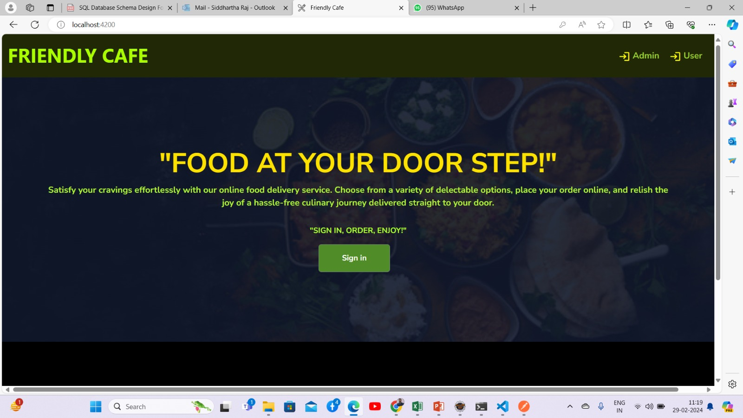
Screeenshots- home page

Slide 25
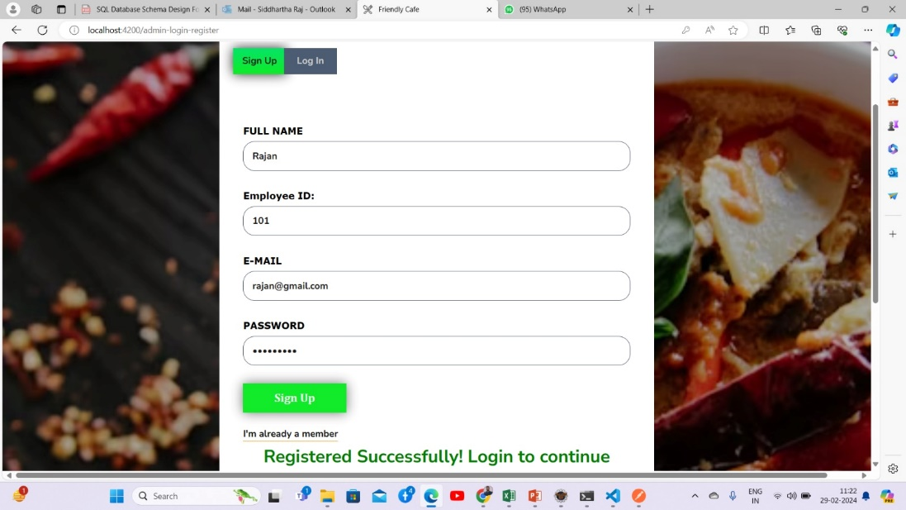
Admin Sign Up

Slide 26
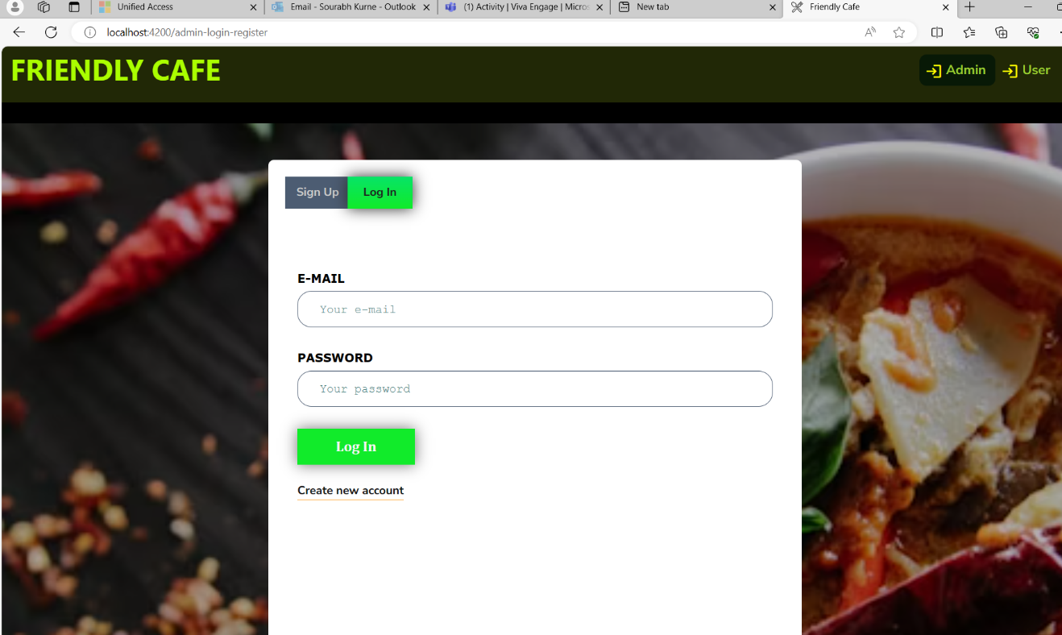
Admin Log In

Slide 27
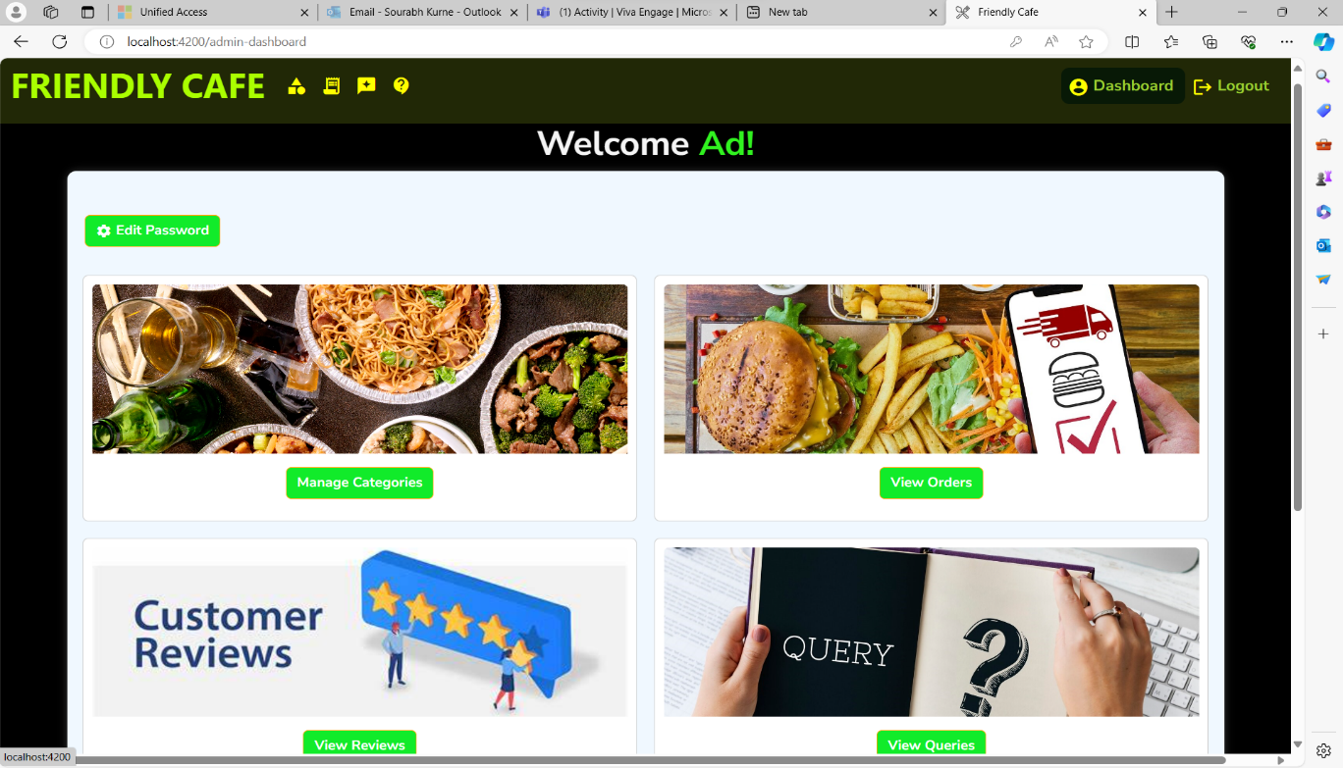
Admin dashboard

Slide 28
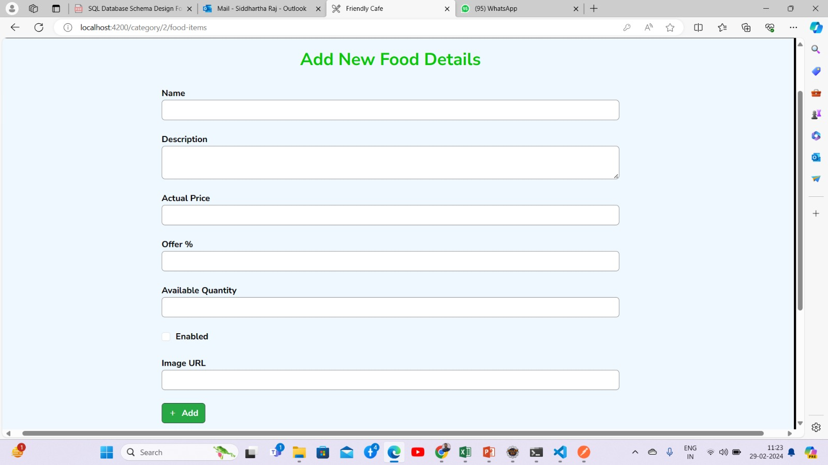
Admin – Add new food details

Slide 29
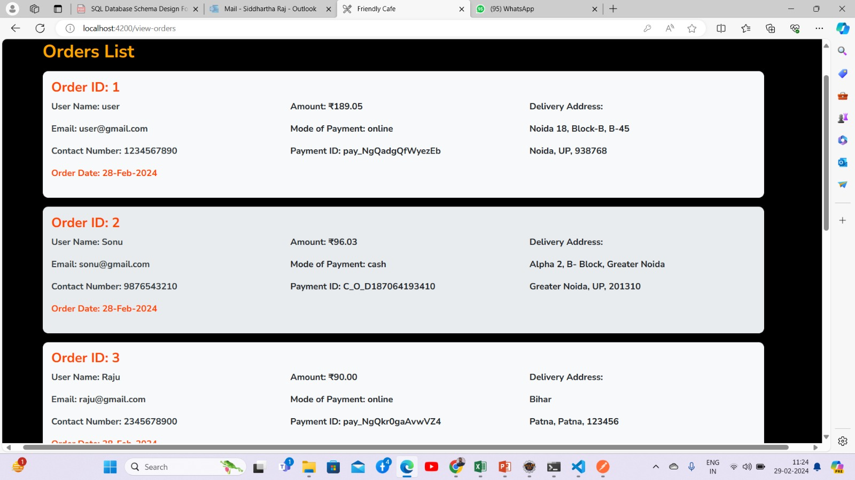
Admin – Order list

Slide 30
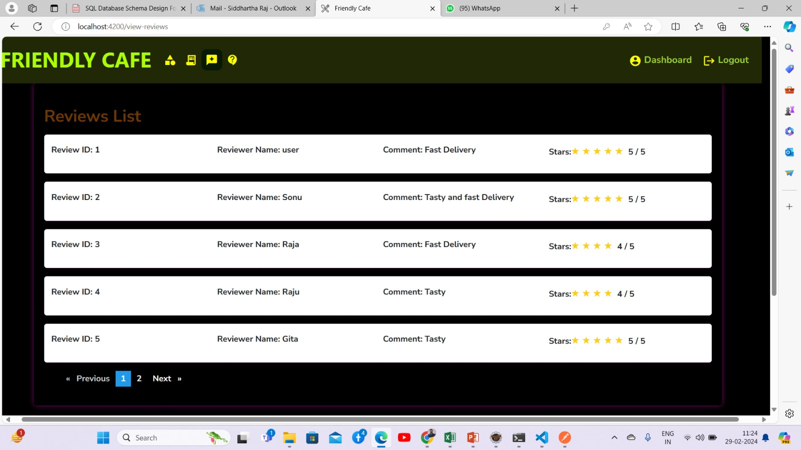
Reviews List

Slide 31
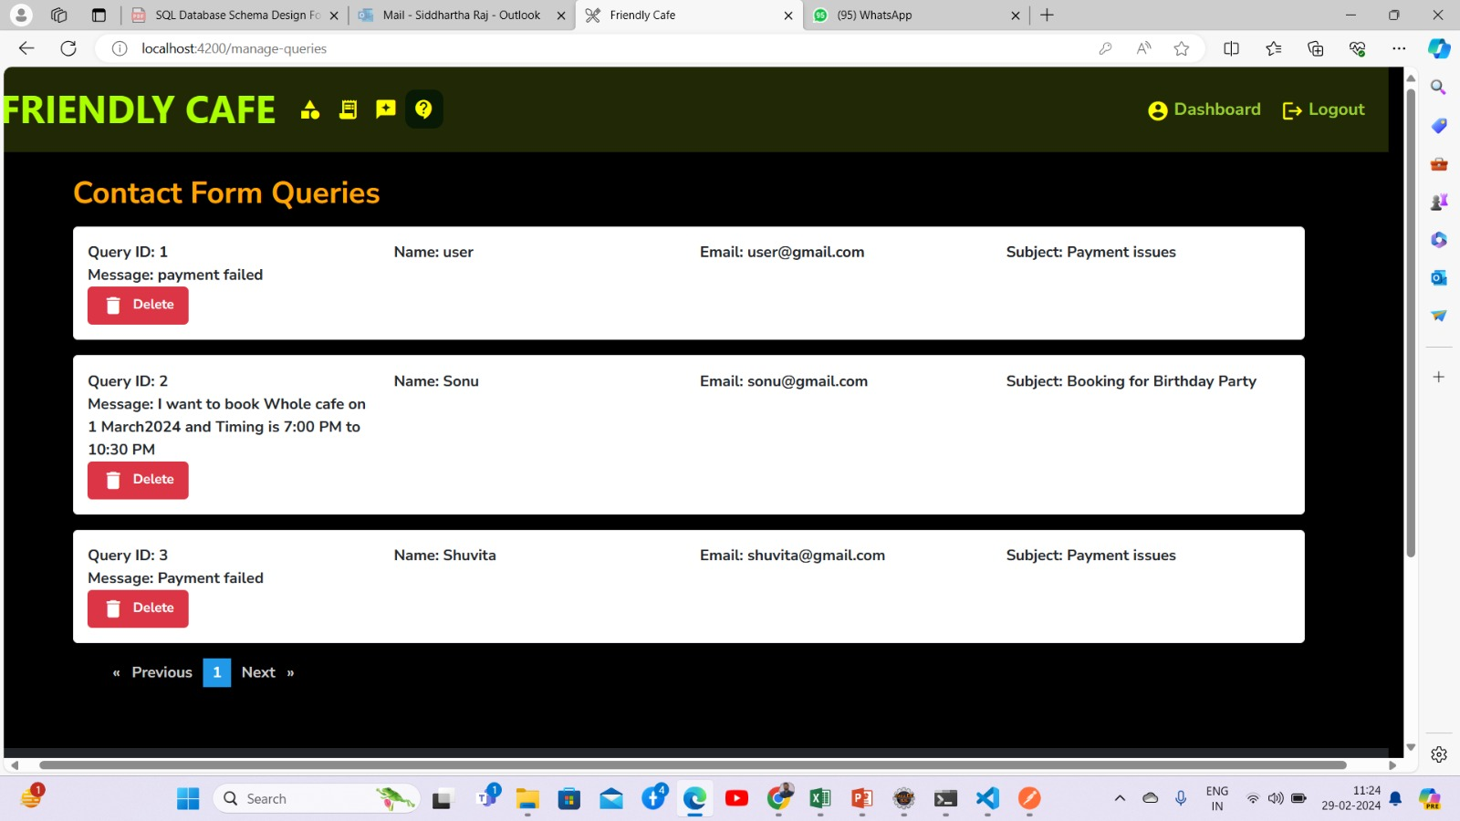
Contact Form Queries

Slide 32
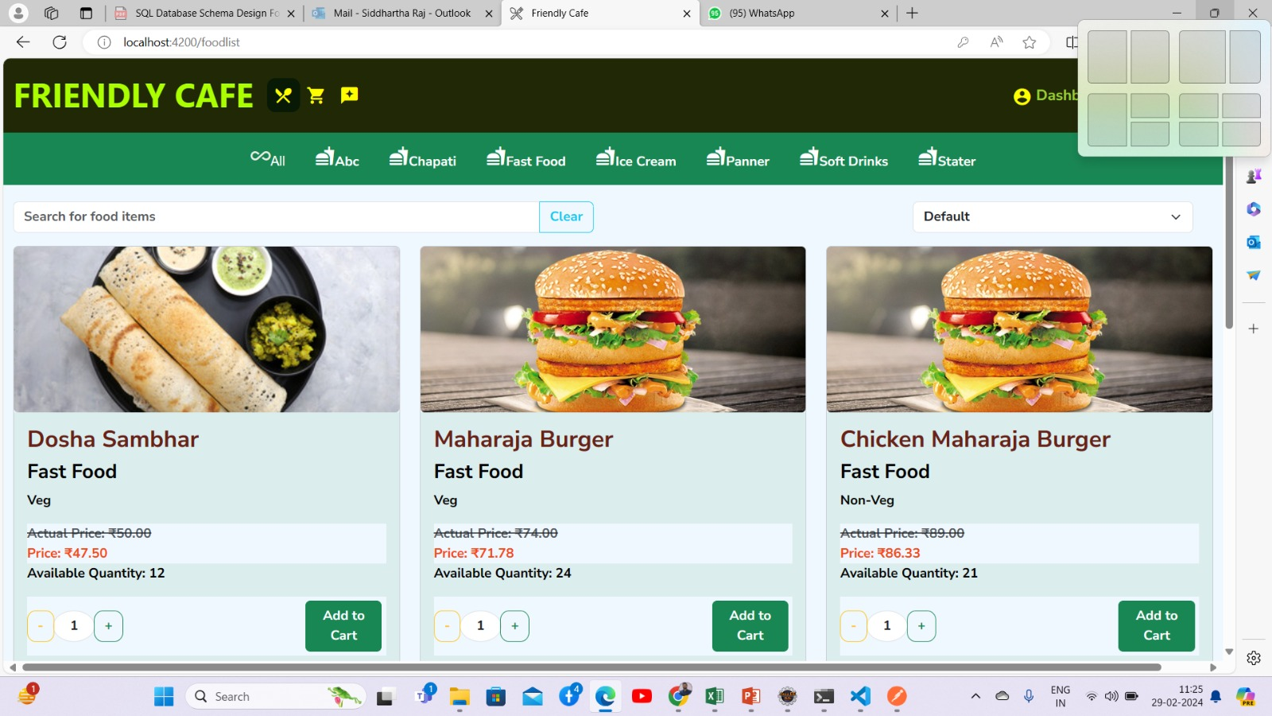
Food Controller

Slide 33
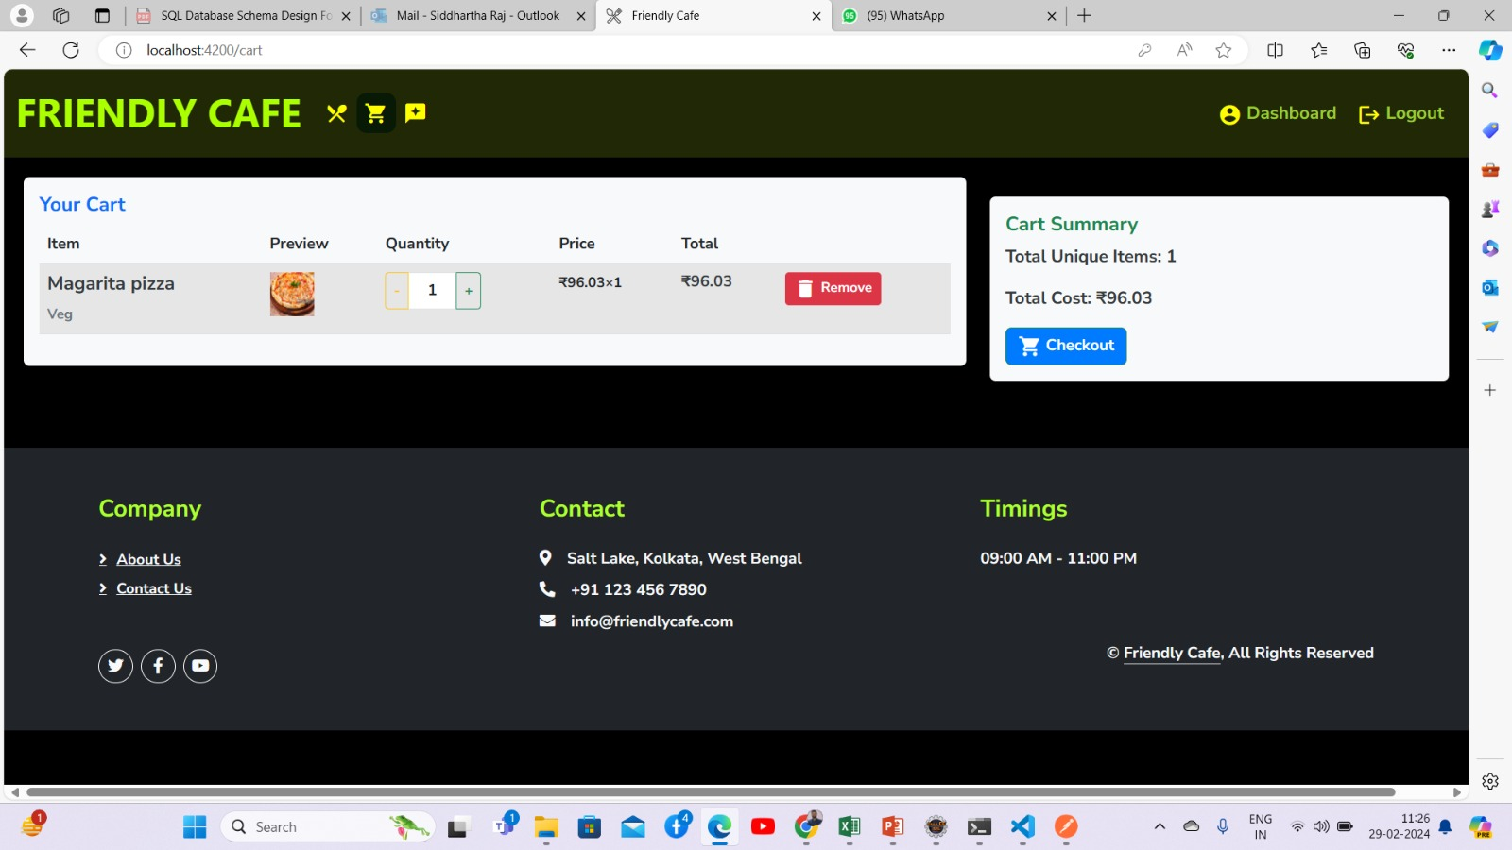
Your Cart

Slide 34
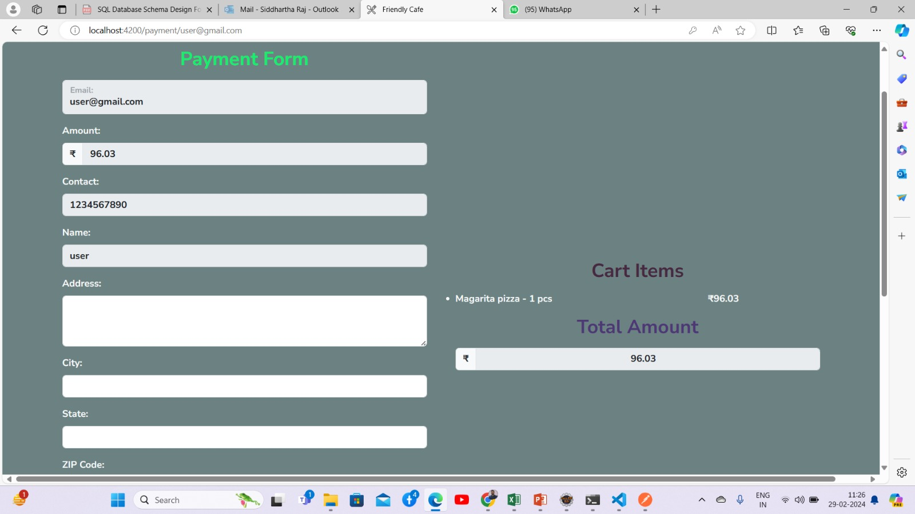
Payment Form

Slide 35
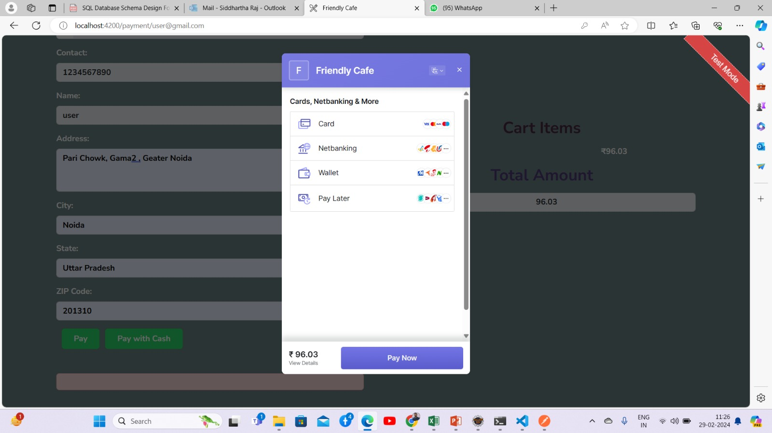
Payment

Slide 36
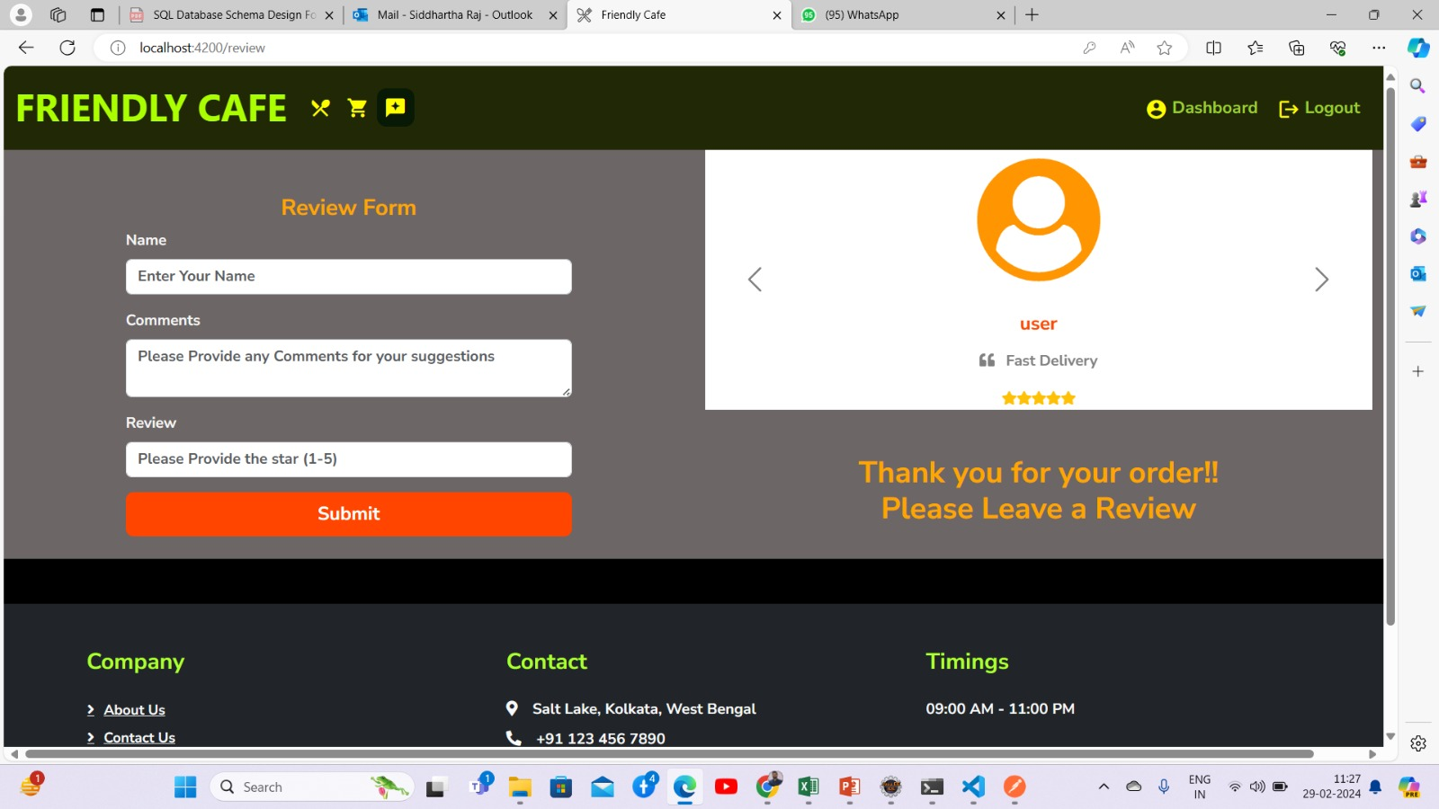
Review Form

Slide 37
Thank you

